Slide 1

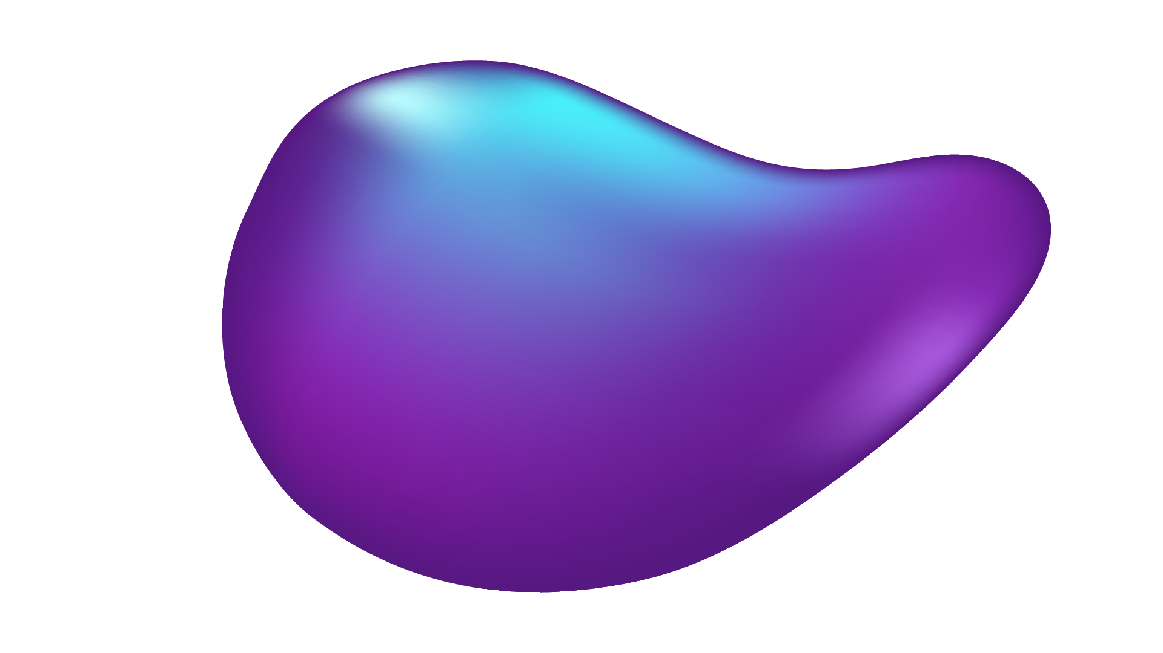
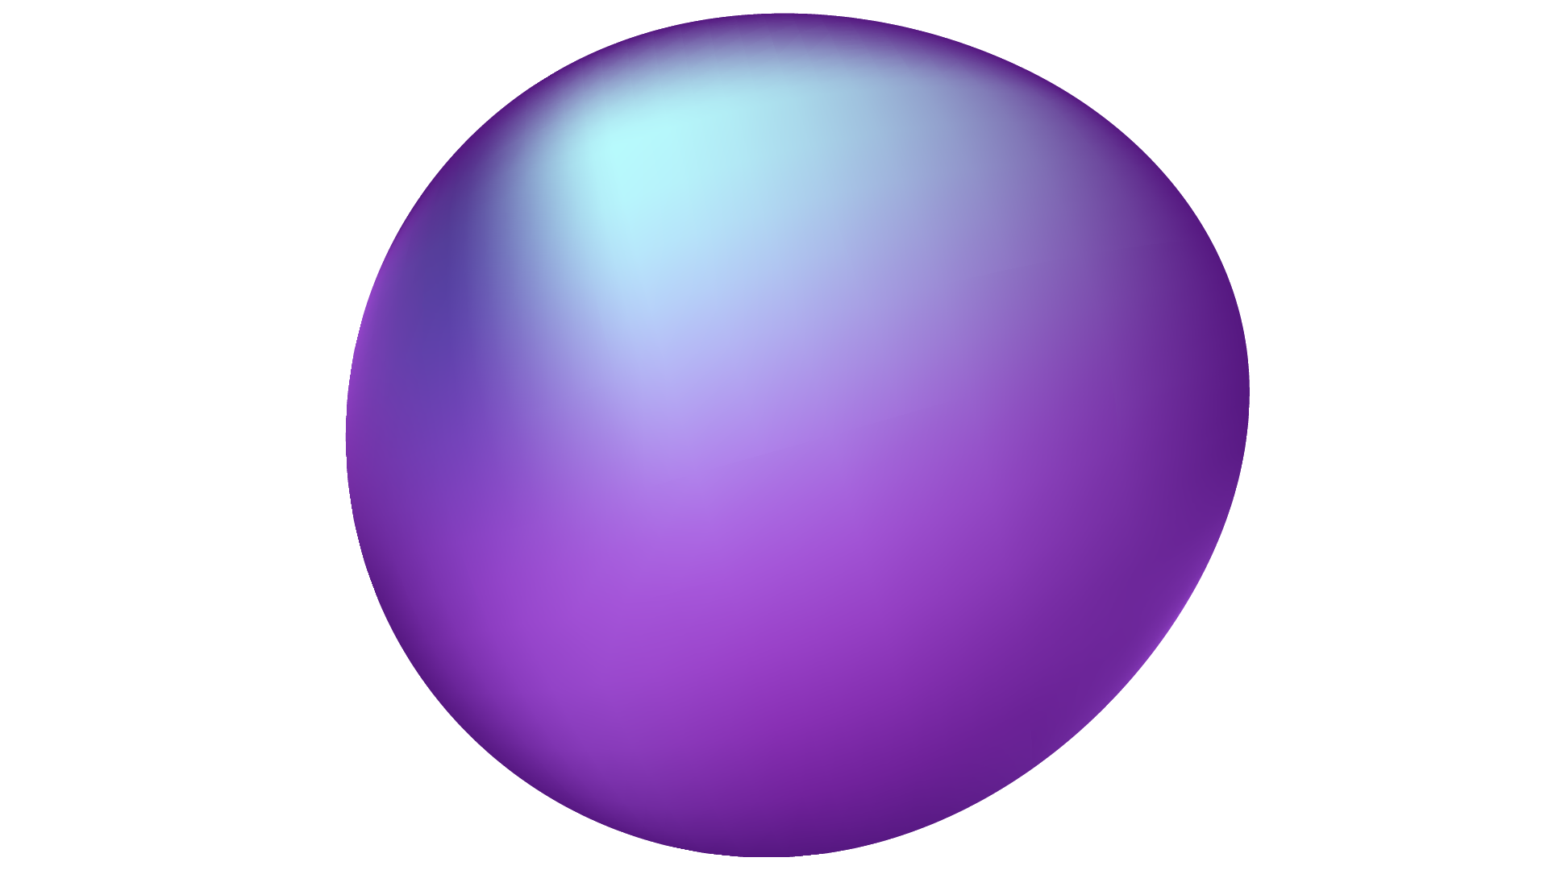
SEMANTIC SEARCH ENGINE
PROJECT
--by Revelli Ramana

Slide 2
TABLE OF CONTENTS
01
02
03
04
05
About The Project
Data Preprocessing
Vectorization
Semantic Search Engine Development
Result Retrival & Display

Slide 3
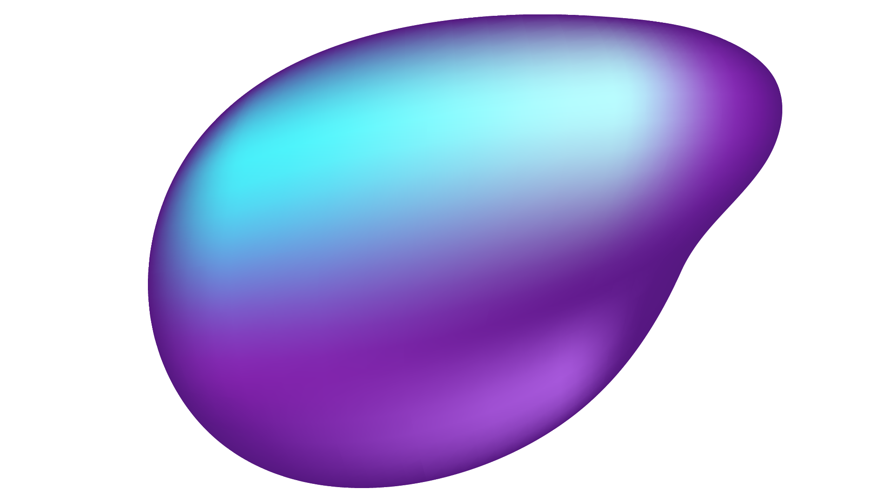

01
ABOUT THE PROJECT

Slide 4
This project focuses on improving the search relevance for video subtitles, enhancing the accessibility of video content.
Developing an advanced search engine algorithm that efficiently retrieves subtitles based on user queries, with a specific emphasis on subtitle content. The primary goal is to leverage natural language processing and machine learning techniques to enhance the relevance and accuracy of search results.

Slide 5
02
Data Preprocessing.

Slide 6
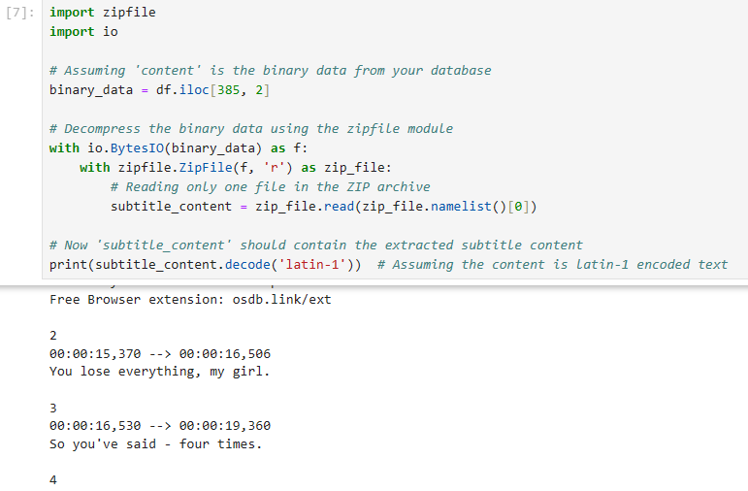
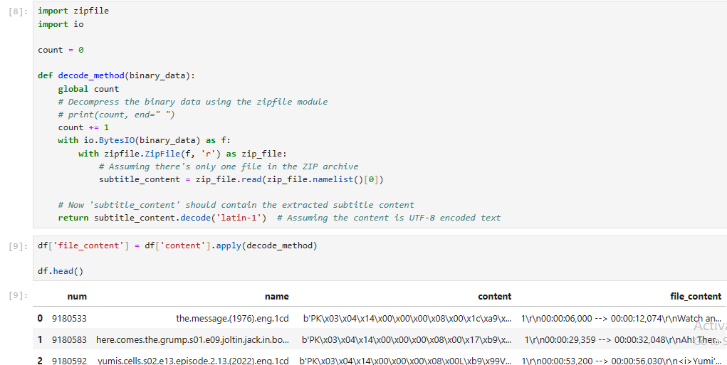
Decoding the data with latin1 decoder.

Slide 7
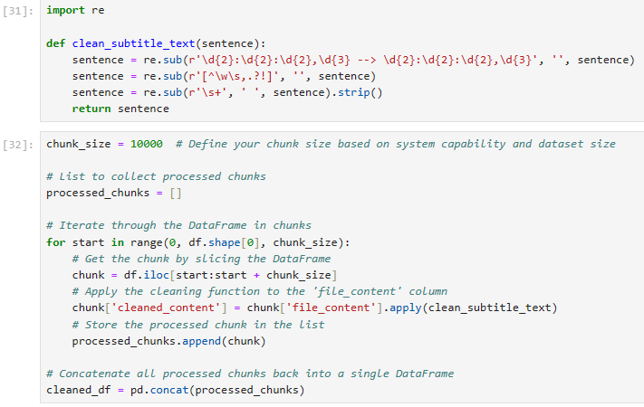
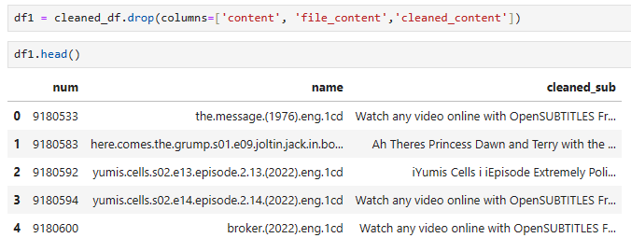
Cleaning the extracted data.
Removal of :
Time Stamps.
Special characters.
Wide spaces.
And dropping the unwanted columns.

Slide 8
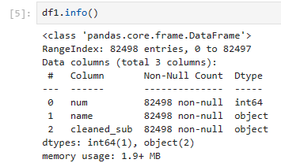
Saving the cleaned data to csv.
The cleaned data consists of 3 dimensions with 82498 rows .

Slide 9
03
Vectorization.

Slide 10
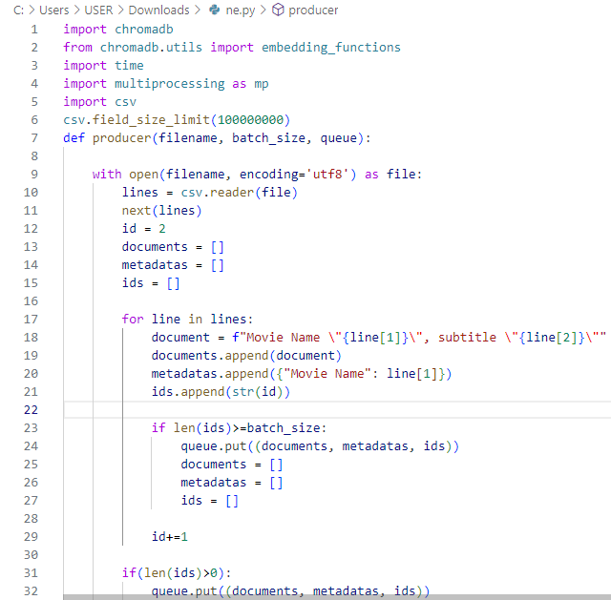
Chromadb to vectorize the data.
Reading the data in csv and storing in form of documents in chromadb and each documents has it unique identity i.e the id.

Slide 11
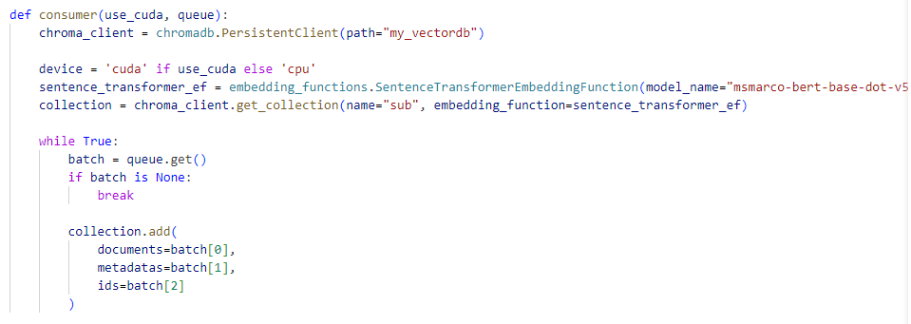
BERT model for sentence vectorization.
By using the GPU the data in the csv divided into different batches and that batches are then tranformed into Vectors using BERT sentence transformer.

Slide 12
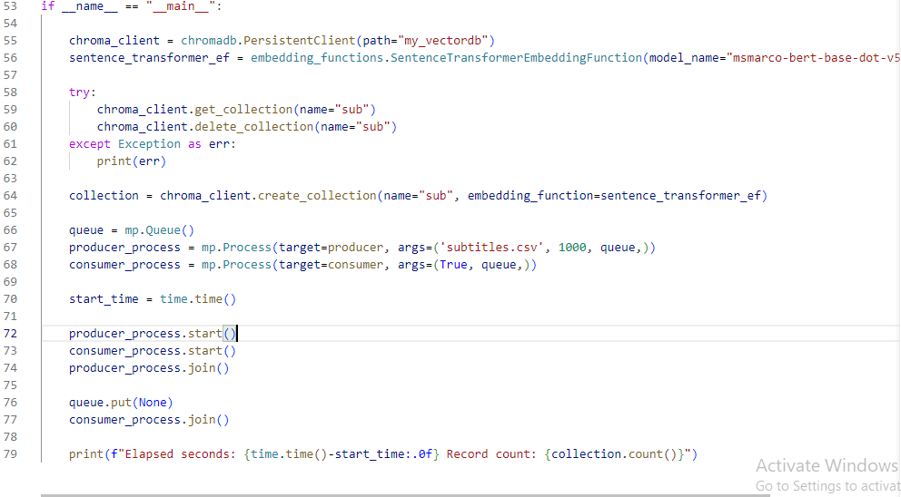
Processing the Vector document.
Storing the transformed vector documents in my_vectordb (path) and also in collection named as sub.

Slide 13
04
Semantic Search Engine Development.

Slide 14
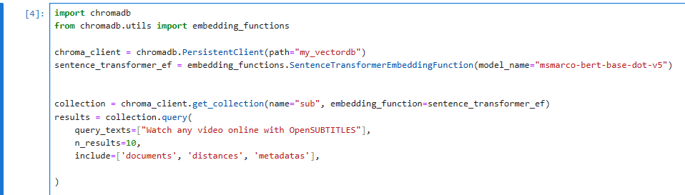
Transforming the Query text.
By using BERT sentence transformer the user query text is transformed in vectors.

Slide 15
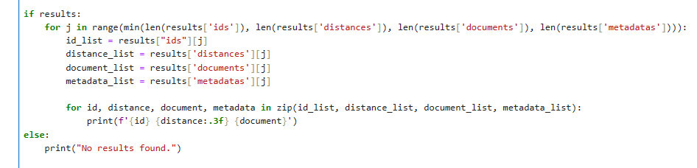
Comparing and Retriving.
Matching the query text with the actual documents in my_vectordb and printing the top 10 search results

Slide 16
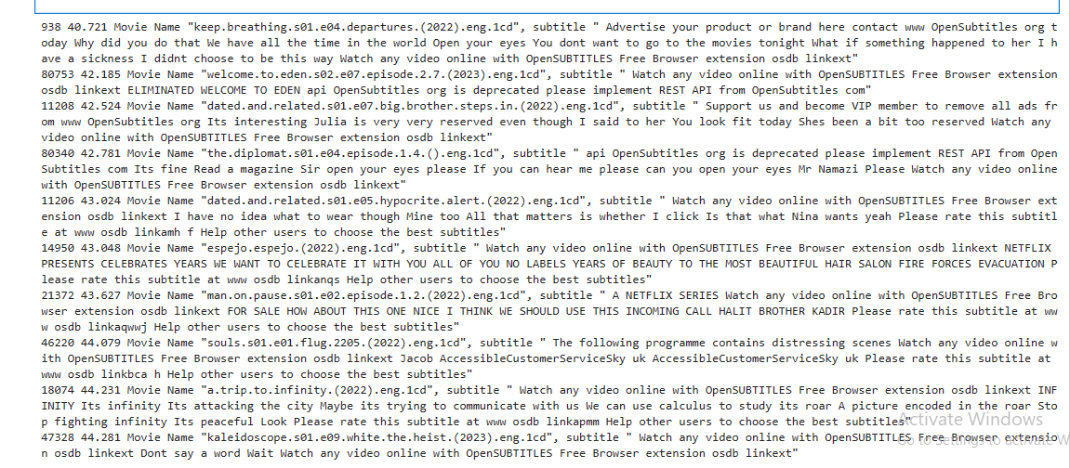
Output of the Results

Slide 17
05
Result Retrival & Display.

Slide 18
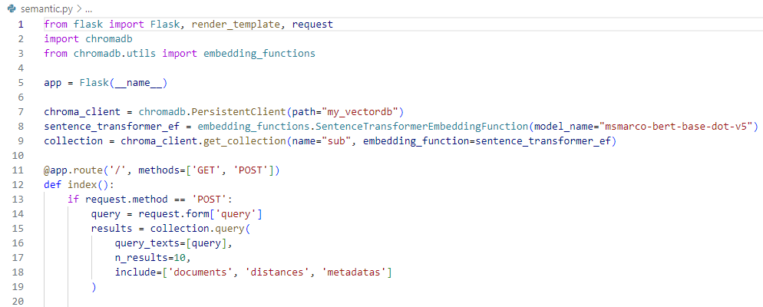
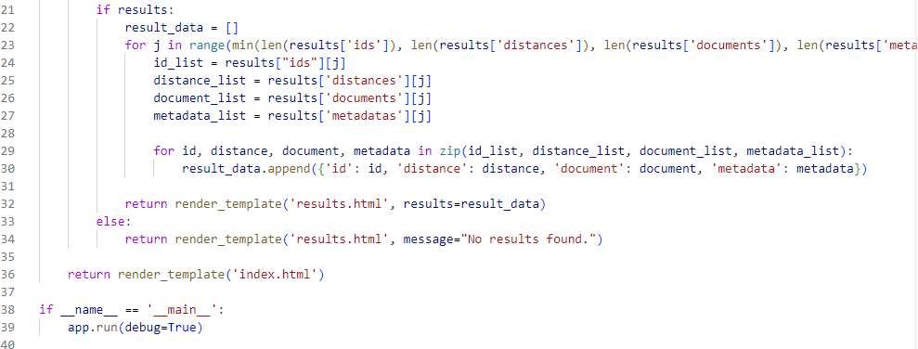
Building Search Engine application using Flask.

Slide 19

Interface of index.html

Slide 20
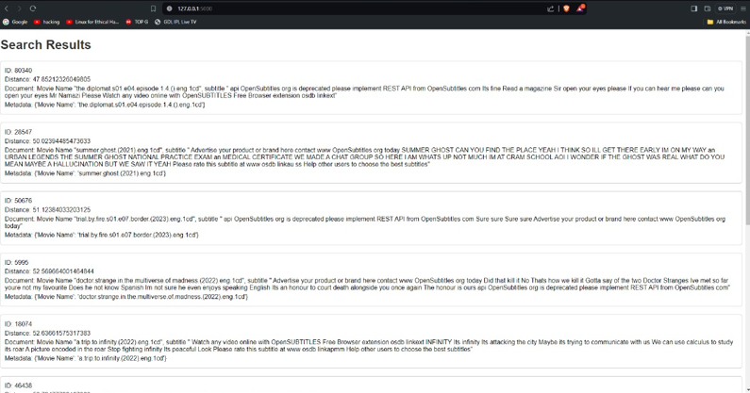
Interface of results.html

Slide 21
THANKS!

